Slide 1
Citizen Journalism at GDA Conference
02.12.2022
Rahel Luder, Florian Maillard
Notes:
Hello everyone, we are delighted to be part of this event today. Rahel und I are working at SWISS TXT, a susdiariary of the Swiss Public Broadcaster SRG. We are doing a research on citizen journalism within the MediaVerse research project together with UAB.

Slide 2
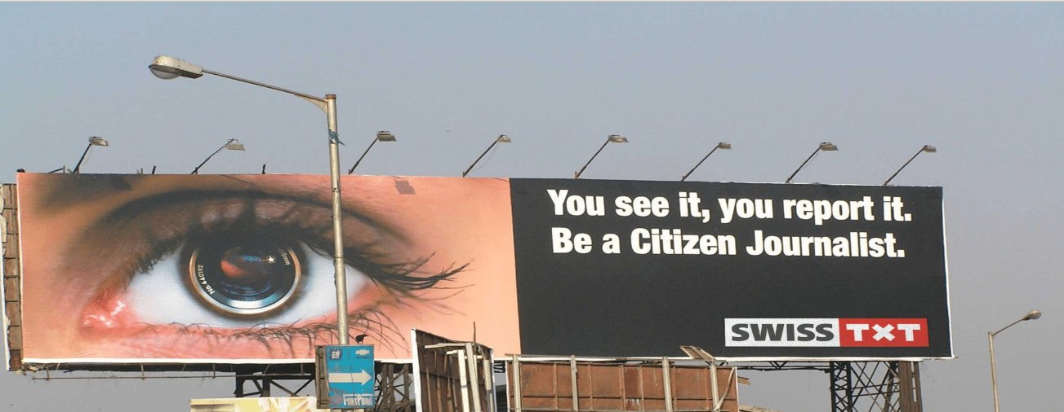
What is Citizen Journalism?
Process of collecting, reporting, analyzing, and disseminating news and information
Mainly in the form of videos and pictures by public citizens.
Can take place everywhere, on events like a conference, demonstrations etc.
Notes:
What is Citizen Journalism? It is the actual process of collecting and reporting information and news. This is mainly done in the form of videos or pictures by public citizens, so basically everyone that participates in an event, like a conference and wants to report about what happened there. As the picture says below, you see, you report it.

Slide 3
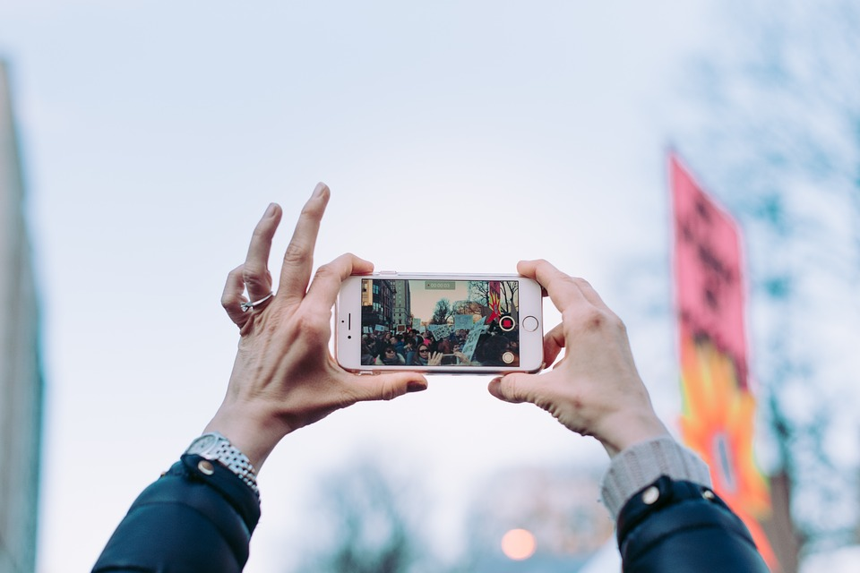
Challenges
We need you to act as citizen journalists today and participate in four challenges:
Challenge 1: Choose one presentation/topic from the conference that inspired you the most and create a short video (max. 20 seconds).
Challenge 2: Create a picture of one poster about CO2 pollution that you found most interesting.
Challenge 3: Find out which items have been recycled at the event.
Challenge 4: Make a short interview of a person asking about his/her thoughts on the event, digital sustainability and what needs to be done in the future.
Notes:
Since we want to find out more about how people create content in different instances, we want you to participate in four challenges in which you will act as citizen journalist.

Slide 4
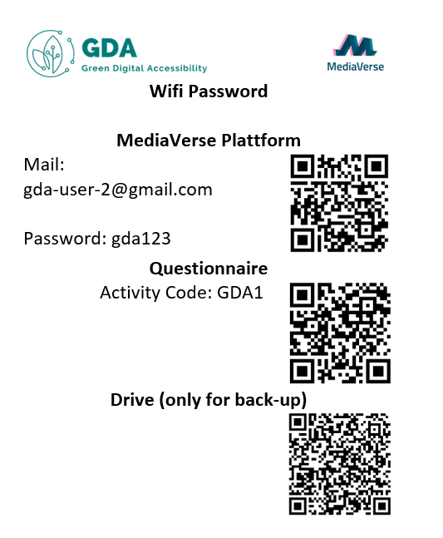
How do I proceed?
Log in into the MediaVerse account with the QR code and the information provided
Create and upload the videos/pictures
Access the questionnaire provided via the QR code
* If MediaVerse doesn’t work, please use the link to drive provided on the sticker.
Notes:
You will have time during the event to think about some ideas and make the video. When your video is done, you can log in into the MediaVerse portal with the QR code and then upload it on the platform. After you have done, we would kindly ask you to answer 3 questions about your experience. At the end, you can come us and we will give you some gifts that we brought with us today. In case the platform doesn’t work since it is still in development, you can access the drive in which you can upload your video.

